Slide 1
Chest X-Ray Classifier
Vrinda Goel (20D070090)
Mohit (20D070052)
Tejaswee (20D070082)
Vinayak Goyal (20D070088)
Disha Pabri (20D070027)

Slide 2
PROBLEM STATEMENT
Train a model to classify images of Chest X-Ray(Input) for finding underlying disease (Output)
Improve accuracy and reliability of machine learning models in disease classification of chest X-Rays
Compare different models and set up a Federated learning prototype
Employing Wavelets in classification techniques

Slide 3
MOTIVATION
In the ever-evolving landscape of data-driven technologies, we're poised to embark on a transformative journey within the healthcare sector. The health industry already accounts for around 30% of the world's data, a number that's projected to surge to 35-40% by 2025.
So, Why not harness this vast reservoir of data by leveraging the power of AI?
Our project is driven by the need to improve medical diagnostics and patient care through the power of AI in analyzing Chest X-rays, reducing the burden on healthcare professionals while improving patient care.
And, perhaps, earn some top-notch grades along the way xD
Reference for data statistics: class notes

Slide 4
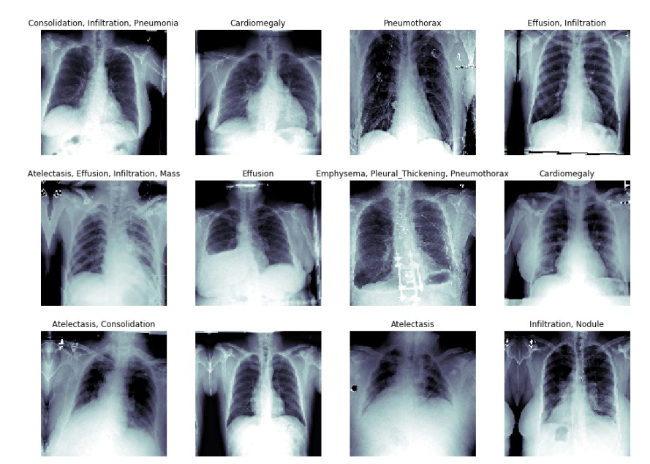
CHEST X-RAY 8 DATASET
108,948 frontal x-ray images
Images labelled with 14 different medical conditions
32,717 unique patients
Hernia
Cardiomegaly
Emphysema
Effusion
Infiltration
Mass
Nodule
Atelectasis
Pneumothorax
Pleural_Thickening
Pneumonia
Fibrosis
Fibrosis
Edema
Consolidation

Slide 5
IS IT A CLASSIFICATION OR REGRESSION PROBLEM?

Slide 6
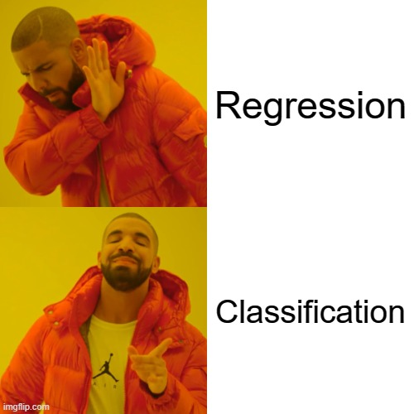

Slide 7
DATA PROCESSING
1) DATA LEAKAGE MITIGATION:
Ensured that split is done on the patient level so that there is no “leakage” between the train, validation and testing datasets
2) IMAGE PREPARATION:
Used data augmentation and standardized the input distribution to mean 0 and std deviation 1
Converted single channel X-ray images( grayscale) to three-channels for using pretrained model
Shuffle the input after every epoch and set the image size to be 320px by 320px
3) HANDLING DATA IMBALANCE:
Prevalence of positive cases varied significantly across the different pathologies
Multiplied each sample from each class by a class-specific weight factor, w_pos & w_neg
This will ensure that overall contribution of each class is same

Slide 8
TECHNIQUES
/MODELS
/ARCHITECTURES

Slide 9
General Remarks for All Models
Loss Function
Optimizer
Learning Rate
Metrics
Weighted Mean Squared Error Loss (1/N) * Σ[weights * (y_true- y_pred)^2]
Adam The most commonly used and currently the best optimizer for ML Models
Built a custom learning rate scheduler which changes values according to the training loss
ROC Curve Number of Epochs - 5 Base Classification Model with a Classifier built upon it

Slide 10
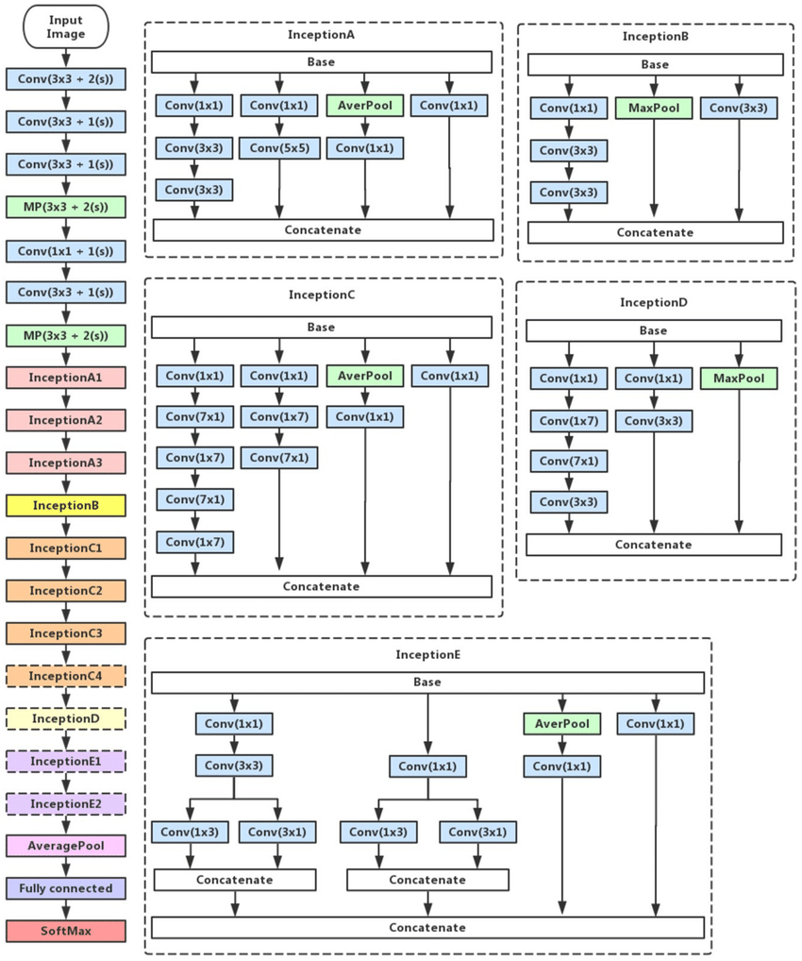
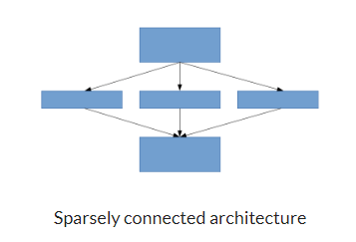
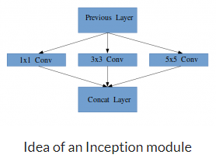
BASE MODEL 1
INCEPTION
Handles deep neural networks with reduced computational cost
Uses sparsely connected architecture
Source: https://arxiv.org/abs/1409.4842

Slide 11
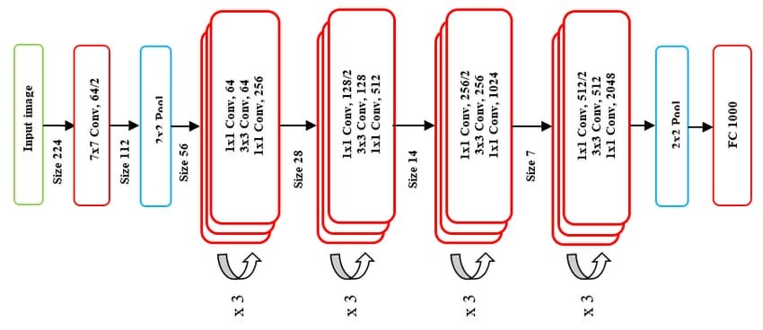
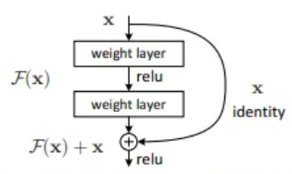
BASE MODEL 2
ResNet
Introduced residual connections to address vanishing gradient problems
Fit a residual mapping instead of directly trying to fit a desired underlying mapping
Source: https://arxiv.org/abs/1512.03385

Slide 12
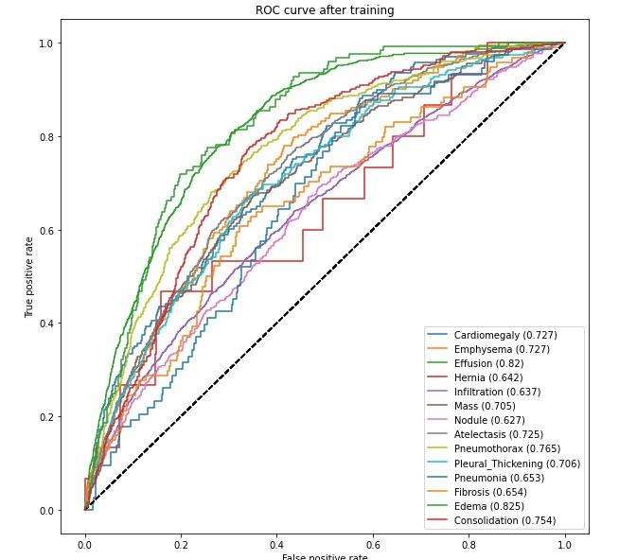
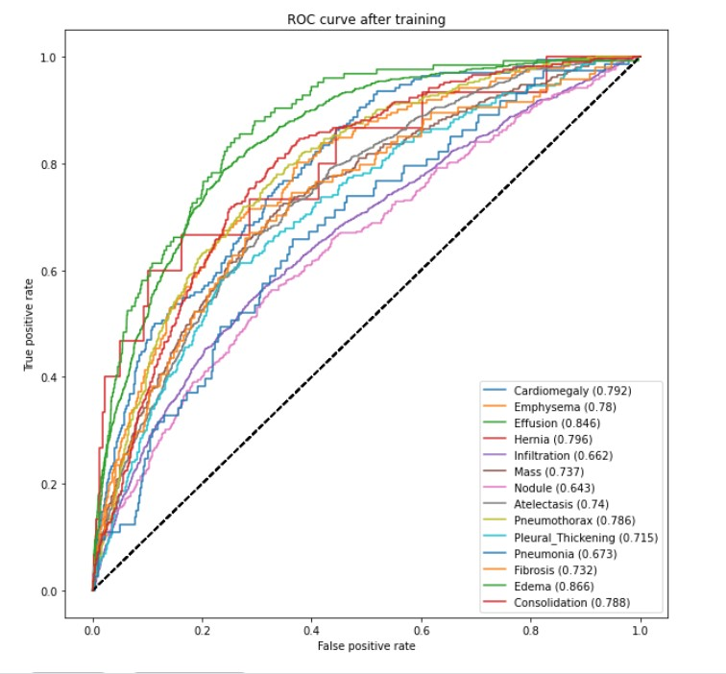
RESULTS
ROC for training with INCEPTION as the base model
ROC for training with RESNET as the base model

Slide 13
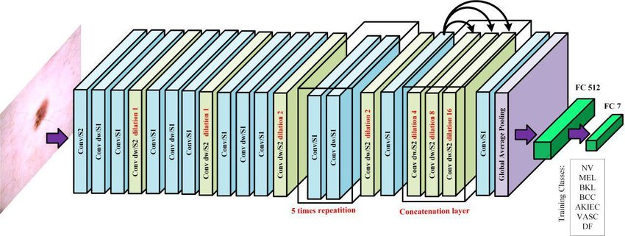
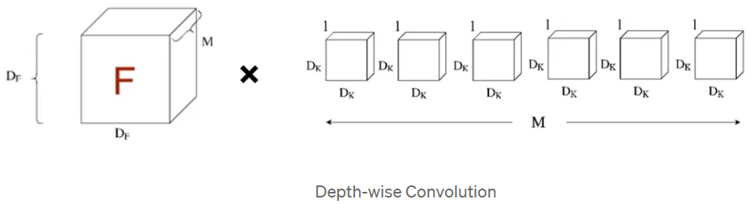
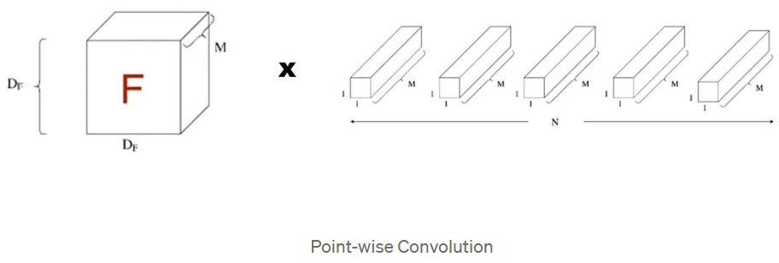
BASE MODEL 3
MOBILENET
Uses Depth-wise separable convolutions
Consists of 2 layers -> Depth-wise convolution and Point-wise convolution
Depth-wise convolution - Filter the input channels
Point-wise convolution - Combine them to create a new feature
Source: https://arxiv.org/abs/1704.04861

Slide 14
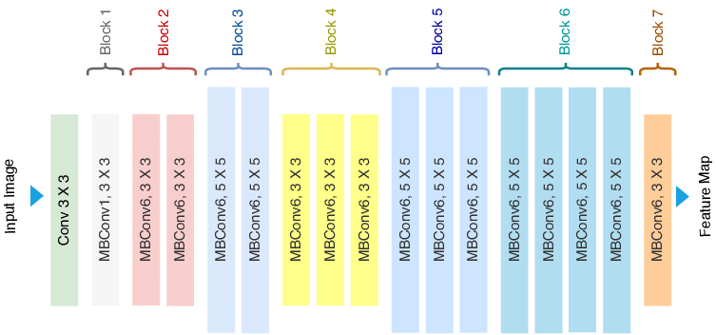
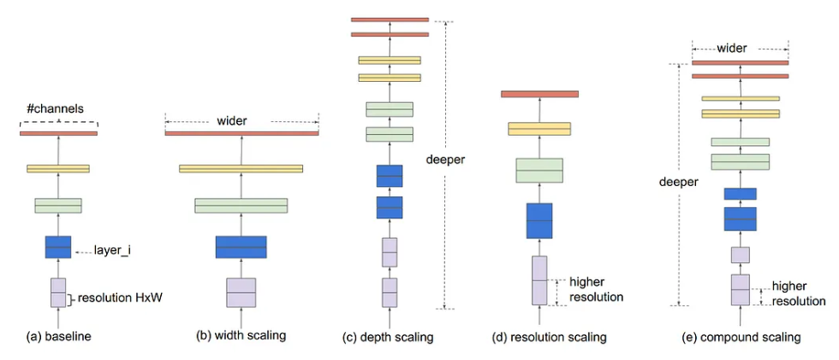
BASE MODEL 4
EfficientNet
Uses Compound Scaling, including depth, width and resolution scaling
Based on the idea of balancing dimensions of width, depth, and resolution by scaling with a constant ratio
One of the most power CNN architecture
Source: https://arxiv.org/abs/1905.11946

Slide 15
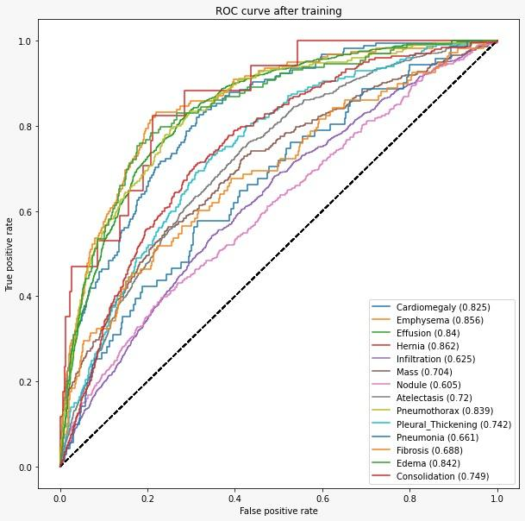
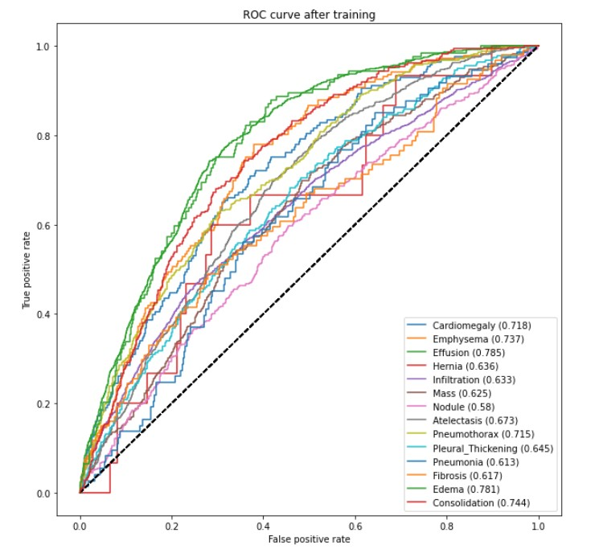
RESULTS
ROC for training with EFFICIENTNET as the base model
ROC for training with MOBILENET as the base model

Slide 16
CONCLUSIONS
Accuracy order observed from above ROC curves is as follows: EfficientNet(2019) > ResNet(2015) > Inception(2014) > MobileNet(2017)
In practise, EfficientNet is often considered state-of-the-art for a wide range of tasks due to its efficiency- accuracy trade off but it requires abundant computational resources.
For a robust and easy to train model which doesn’t require many computational resources, ResNet is most preferred.
MobileNet is specialized for mobile vision applications and resource-constrained environments. While it excels in these contexts, it may not be a good choice for general image classification tasks on high performance hardware which is evident from its accuracy
Inception is known for its computational efficiency and competitive performance but it is a quite old model and many new models have replaced this

Slide 17
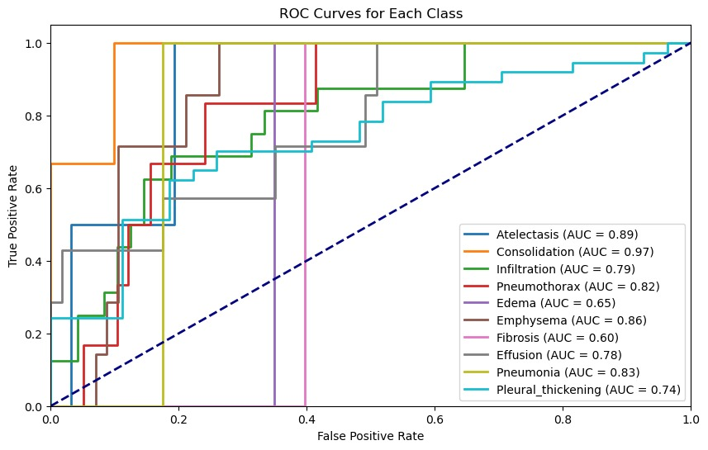
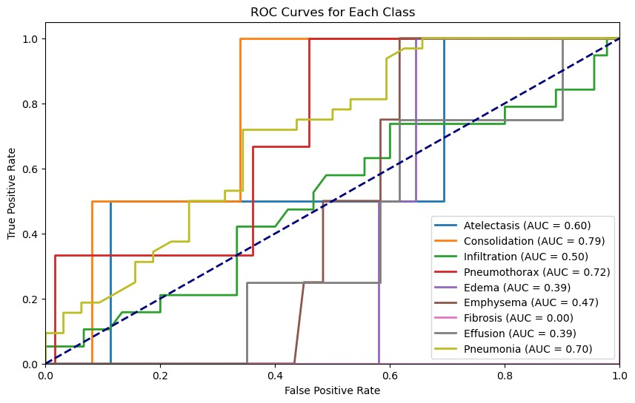
MODEL 5
Federated learning
Next, we tried using federated learning that we learnt in the course. We used ResNet for each client while making sure that no data leakage occurs within test-train split and splitting of the data amongst the clients. These clients essentially function as distinct models, and their collective insights are amalgamated at the conclusion of our process.
ROC for a model trained on 1/10th and ½ of the actual dataset respectively. We used 10%/50% of the original data to fine-tune a pretrained ResNet-34 model
https://arxiv.org/ftp/arxiv/papers/2205/2205.09513.pdf

Slide 18
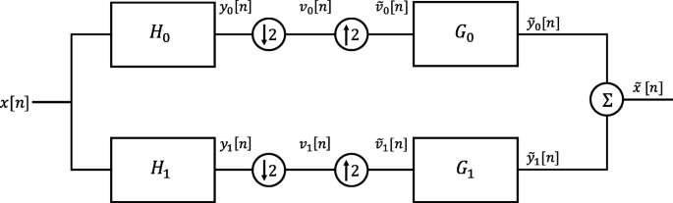
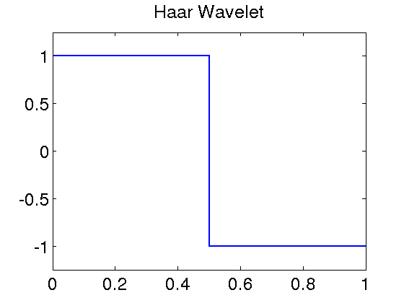
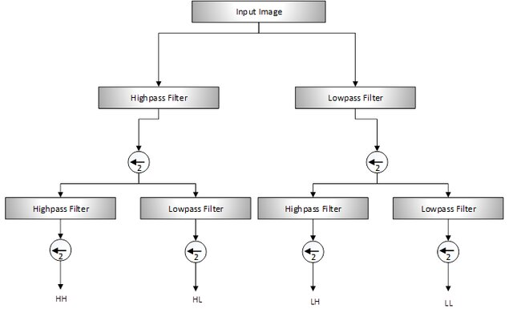
MODEL 6
Federated Learning with Wavelet Transform
1D Multi-resolution analysis
We preprocessed the gray-scaled images using Haar DWT. We took the low frequency components which was relatively noise free. We then trained the model using the LL filtered images. The LL filtered image is the approximate representation of the whole image and HL, LH and HH represent the fine details along the horizontal, vertical and diagonal respectively.
2D Multi-resolution analysis
Links: link1 , link2, link3

Slide 19
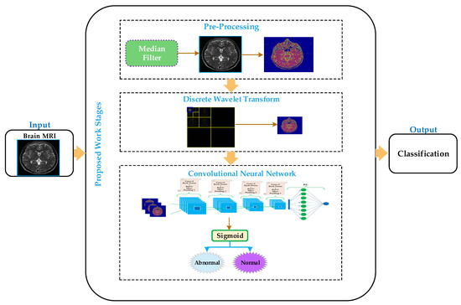
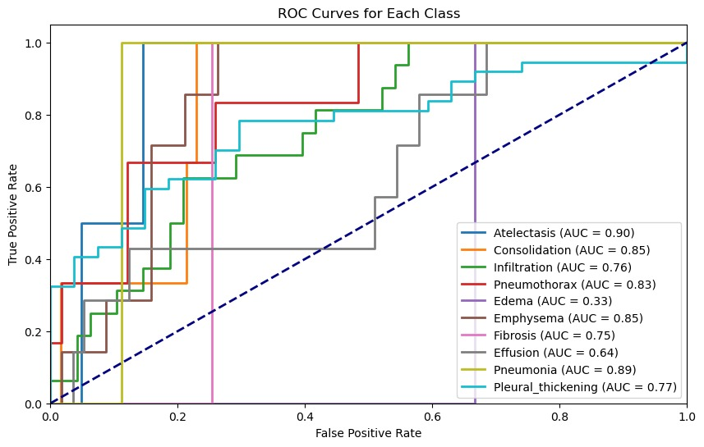
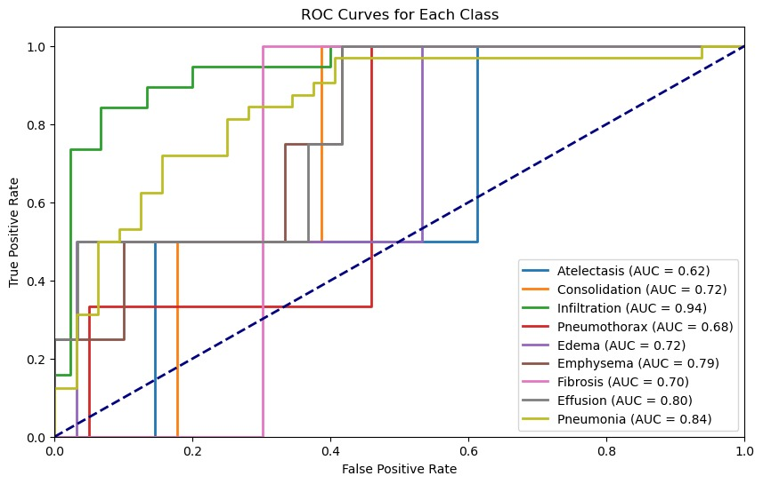
MODEL 6
Federated Learning with Wavelet Transform Results
ROC for a model trained on 1/10th of the actual dataset.
ROC for a model trained on 1/2 of the actual dataset. We used the same ResNet-34 pretrained model to be fine-tuned.
Links: link1

Slide 20
PROPOSED/ FUTURE WORK
HARNESSING THE CONCEPT OF WAVELETS TO THE FULLEST
We have not used wavelets to the fullest extent. Using HL, LH, and HH is very useful in fine feature extraction.
It has been found that using wavelets transform for feature extraction reduces the model parameters to a huge extent and also give similar results after less training then CNNs
Fourier transform gives us information about the magnitude of a frequency component (presence), wavelet transform tells us the location along with the magnitude, but Shearlets allow us to perceive direction also.

Slide 21
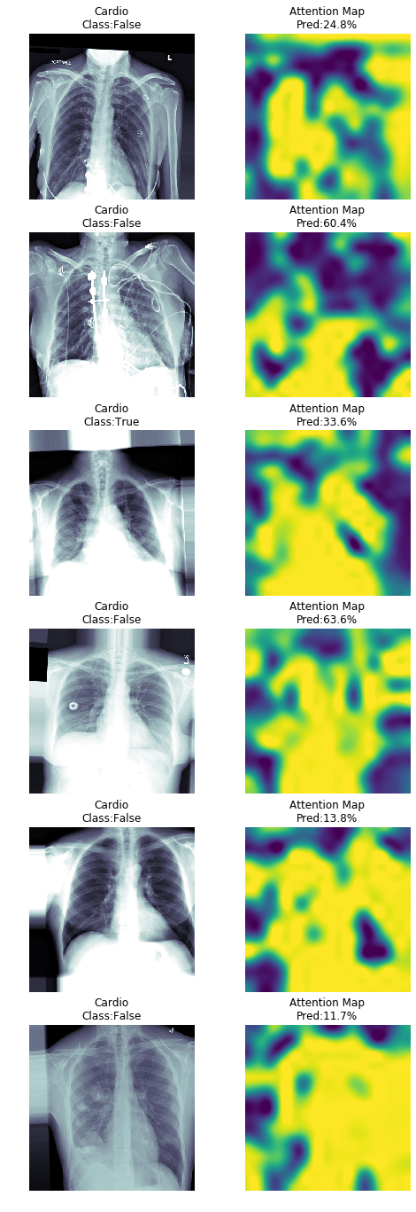
2) USING ATTENTION MODEL
Global Average Pooling(GAP) is too simplistic since some of the regions are more relevant than others
Use an attention mechanism to mask out the most useful values for the classification ( helps the model learn to avoid shoulder, bones and so forth)
Example - Classification of Cardiomegaly ( All attention should be focused on heart region)

Slide 22
REFERENCES
Difference between models-medium
Szegedy, Christian, et al. "Going deeper with convolutions." Proceedings of the IEEE conference on computer vision and pattern recognition. 2015.
He, Kaiming, et al. "Deep residual learning for image recognition." Proceedings of the IEEE conference on computer vision and pattern recognition. 2016.
Howard, Andrew G., et al. "Mobilenets: Efficient convolutional neural networks for mobile vision applications." arXiv preprint arXiv:1704.04861 (2017).
Tan, Mingxing, and Quoc Le. "Efficientnet: Rethinking model scaling for convolutional neural networks." International conference on machine learning. PMLR, 2019.
Konečný, Jakub, et al. "Federated learning: Strategies for improving communication efficiency." arXiv preprint arXiv:1610.05492 (2016).

Slide 23
THANKYOU!

